Slide 1
Neurological Disorders Lesson 3.4
What causes different pain phenomena?

Slide 2
Do Now: True or False
Unmyelinated axons conduct signals faster than myelinated axons.
The body’s internal organs have sensory receptors for pain.
The body’s sense of touch is primarily processed in the motor cortex located in the frontal lobe.
Our emotions do not play any part in processing painful sensations.
Pain information is sent in only one direction – from the body to the brain.

Slide 3
Pain Phenomena Jigsaw

Slide 4
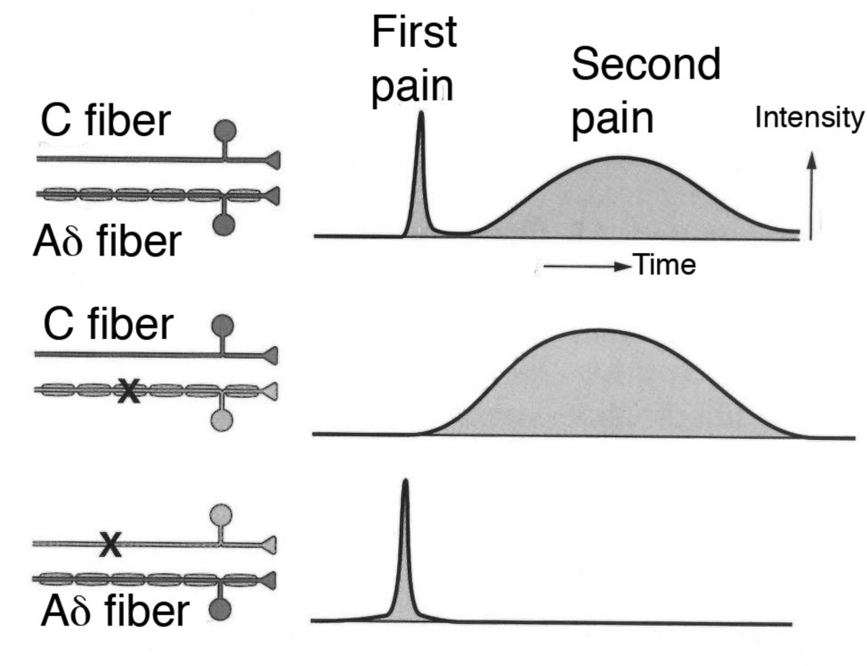
Why do we first feel a stabbing pain, and then later feel an aching pain?
First
Stabbing
Pain
Second
Aching
Pain

Slide 5
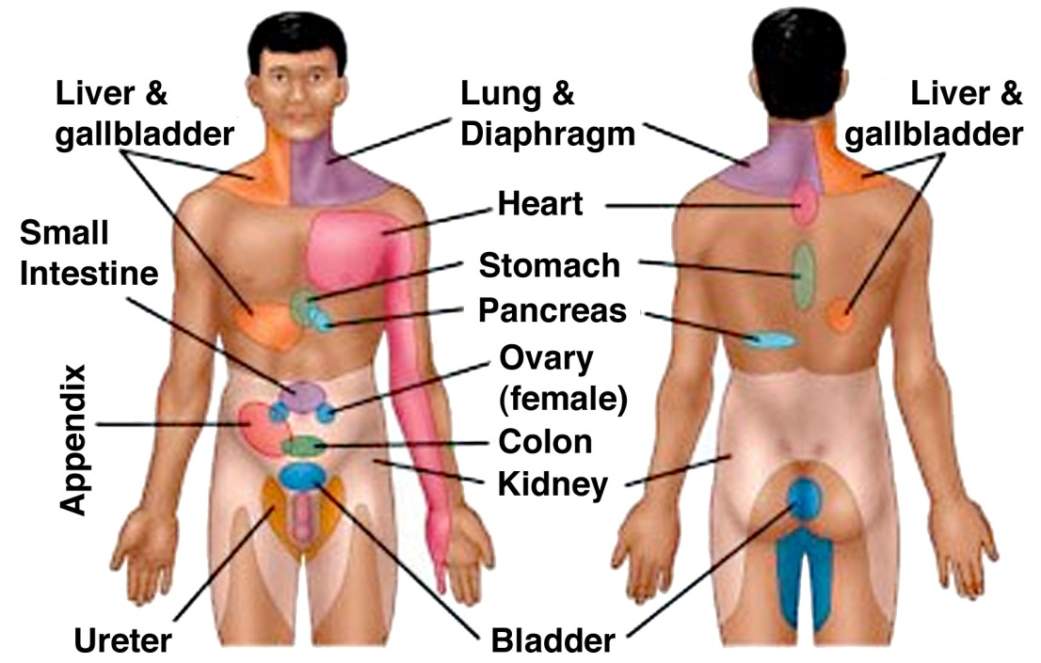
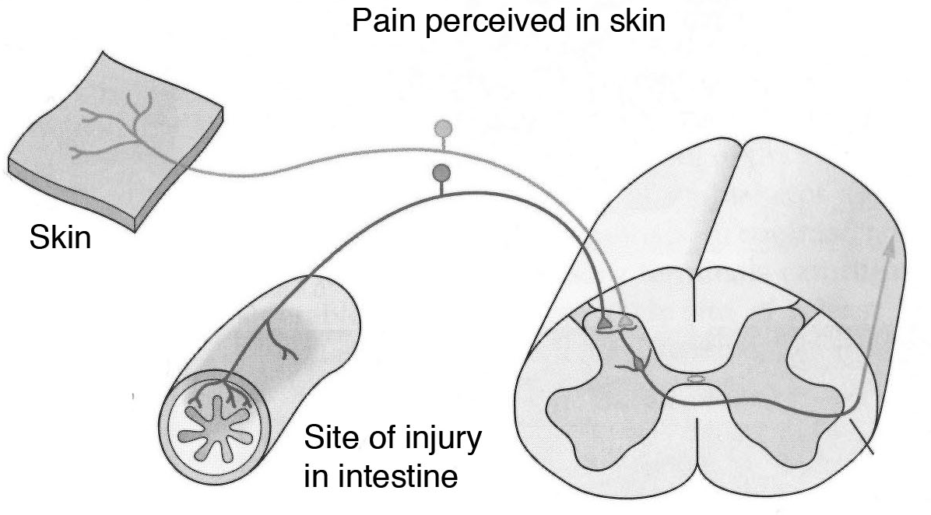
Why do people feel pain in their arm when they are having a heart attack?

Slide 6
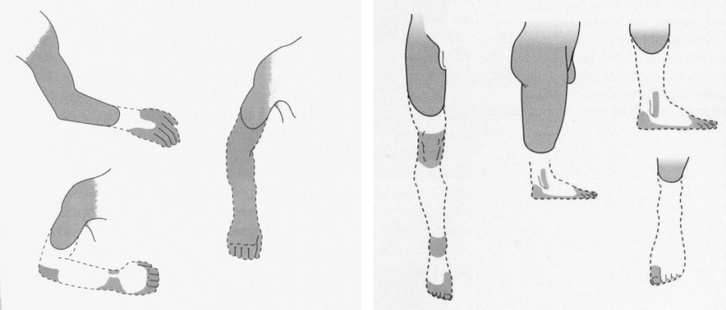
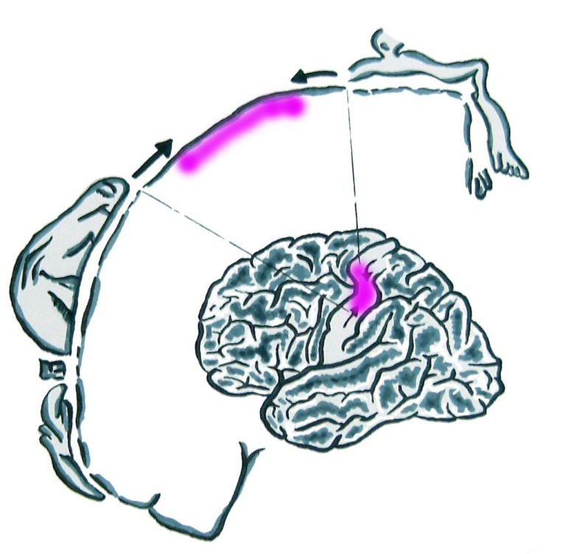
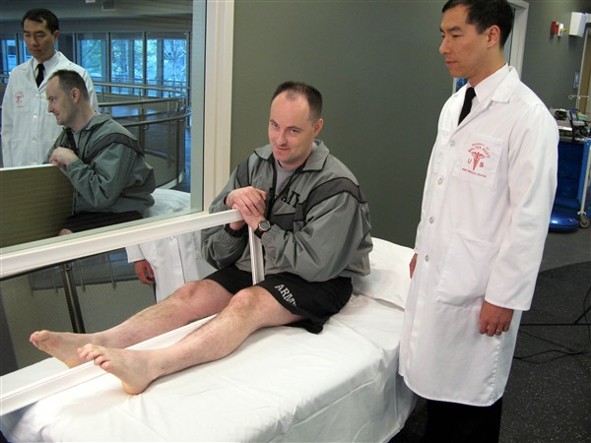
Why do amputees feel pain in their missing limbs?
Phantom Limb Pain
Somatosensory Cortex Missing Input
Mirror Box Therapy

Slide 7
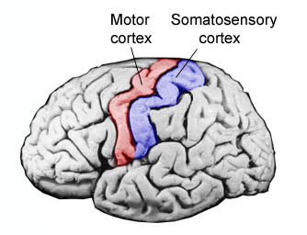
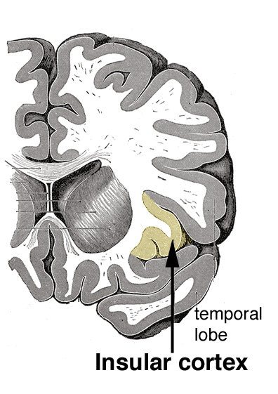
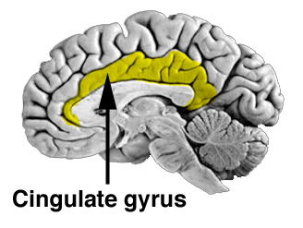
Why do our emotions play a large role in how we perceive pain?

Slide 8
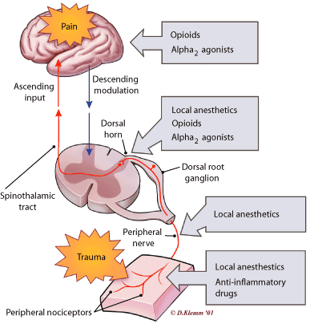
How do medicines that relieve pain work?
Opioids
Ascending
pain pathway
Descending
pain pathway
Opioids
Local anesthetics
Local anesthetics
Anti-inflammatory drugs
Pain Receptors

Slide 9
Wrap Up: True or False
Unmyelinated axons conduct signals faster than myelinated axons.
FALSE
Myelinated axons conduct signals faster than unmyelinated axons.

Slide 10
Wrap Up: True or False
The body’s internal organs have sensory receptors for pain.
TRUE
Highly innervated are the intestines, bladder and uterus. Lungs, liver, and spleen have fewer nerve endings so are less likely to feel pain.

Slide 11
Wrap Up: True or False
The body’s sense of touch is primarily processed in the motor cortex located in the frontal lobe.
FALSE
The body’s sense of touch is primarily processed in the somatosensory cortex located in the parietal lobe.

Slide 12
Wrap Up: True or False
Our emotions do not play any part in processing painful sensations.
FALSE
Our emotions play a large role in processing painful sensations.

Slide 13
Wrap Up: True or False
Pain information is sent in only one direction – from the body to the brain.
FALSE
Pain information is sent in two directions – from the body to the brain, AND from the brain to the body.
Physiology of Pain

